Slide 1
Solar PVC activation

Slide 2
INTRODUCTION
Solar is another source of power on our sites, this document will guide you on how to active or integrate the solar units (Pvc) with the delta BBS.
Its is a necessity to have PVC s enabled or visible on the rectifier (orion) side. This enables
us to limit or set output parameters for the Power converters (PVC) for the type of batteries installed.
Below will be covered;
-Hardware (pvc) Installation
-Orion controller SW upgrade
-Enabling PVC monitoring.
-Setting output parameters (basing on battery type)

Slide 3
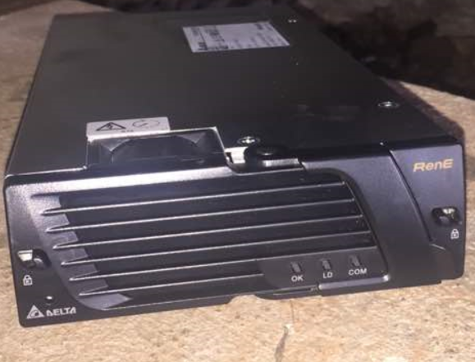
Hardware;
Pvc;
This is a unit which does Dc power conversion in the power system. This type is fed dc voltage ranging from 90 to 350V, this is converted to the set float voltage for the installed battery type.

Slide 4
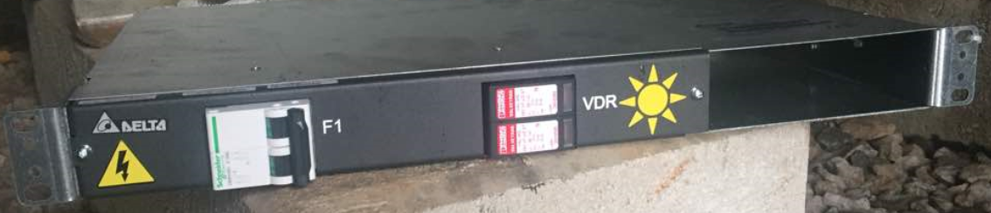
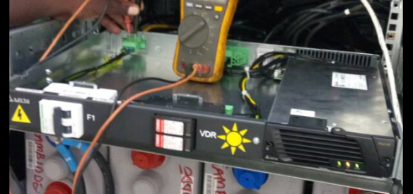
.
This is connected to the dc system through the magazine below
Below is after pvc installation

Slide 5
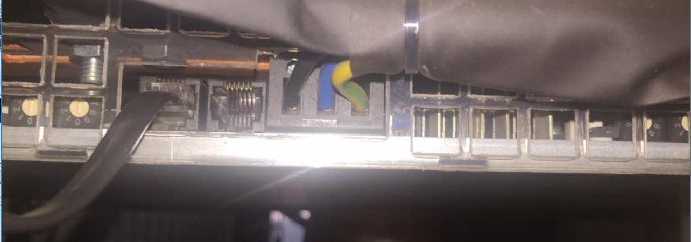
.
For this unit to be visible to the delta/orion controller, below should be done;
-Fixing communication cables
The Pvc and the delta subrack magazines have RJ11 ports at the back.
Delta subrack;
Bare RJ11 port

Slide 6
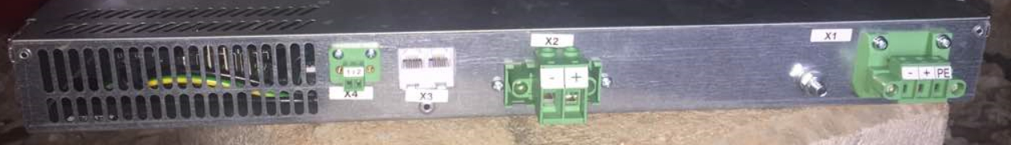
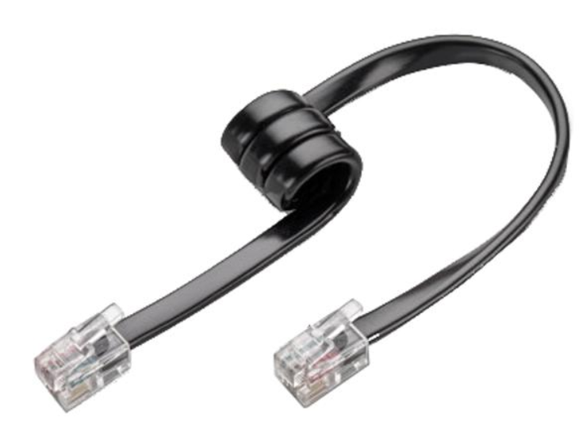
.
Pvc magazine;
Rj11 port , X3
The two points are linked by Rj11 connector communication cable supplied with each unit,

Slide 7
.
The back of the PVC magazine has 2 com ports labelled X3
The first magazine has its port 1 is linked to the delta subrack and then 2 linked to the next PVC magazine.
After fixing the com cable between the delta and the PVC rack, the com light on the pvc should go on to show that the unit is communicating with the delta.
Software;
After laying this connection, the orion controller is then loaded or upgraded to SW
Version 6.51. This is the package which can enable PVC visibility. Hence it is a must for the team to have this package.
It take a maximum of 5 minutes to upgrade the orion.
After the upgrade, take below steps to add pvc on the list of monitored devices.
Configuration system architecture options

Slide 8
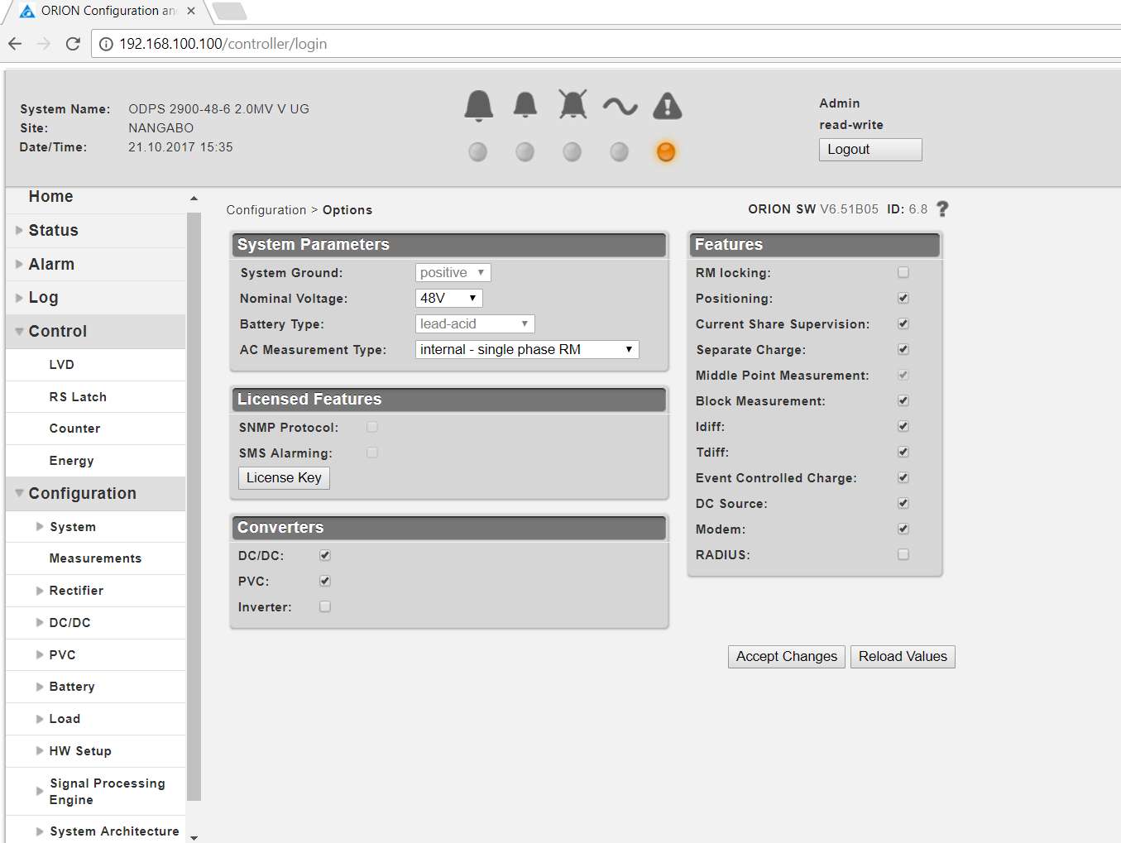
.
On the list of converters, you will see dc dc only enabled. Please do enable the PVC
by inserting a tick in the check box, then click accept changes to save.

Slide 9
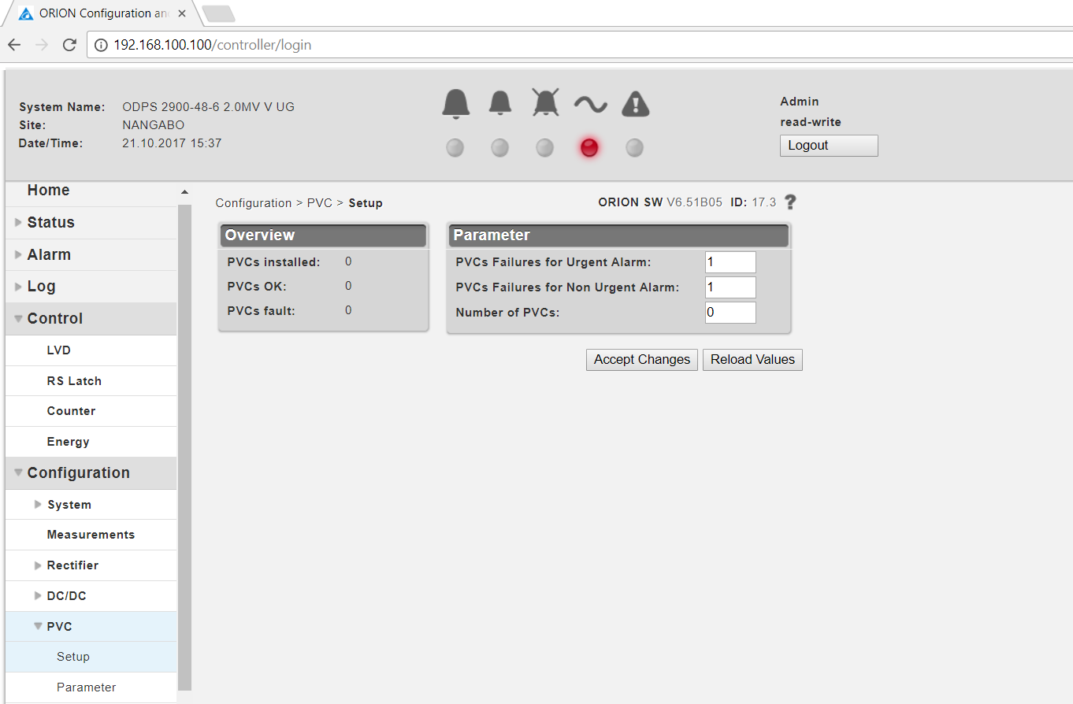
PVC configurations
Next we set the number of pvc, accept changes after.
Steps;
Configurations pvc setup

Slide 10
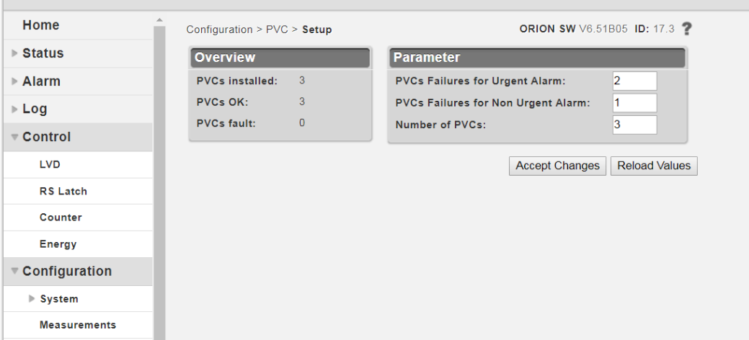
.
If 3 PVCs have been installed and all are ok, below should be seen;

Slide 11
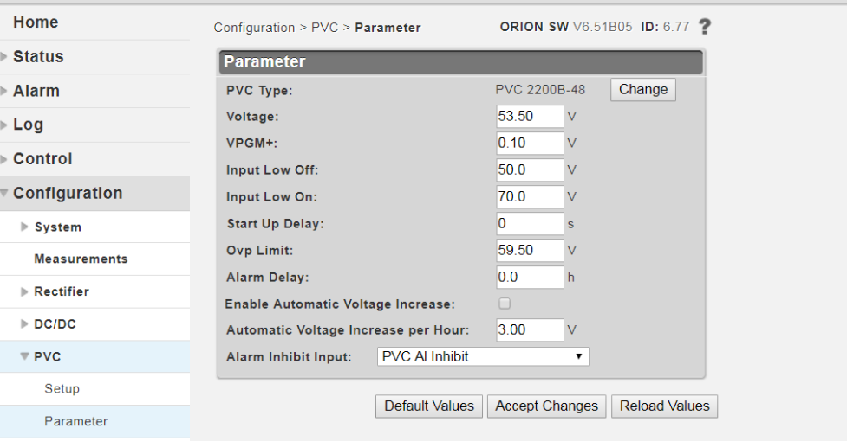
Setting battery parameters;
Steps;
Configuration PVC parameter
The system must be configured as PVC2200B-48, then set battery parameters as per the type at site.

Slide 12
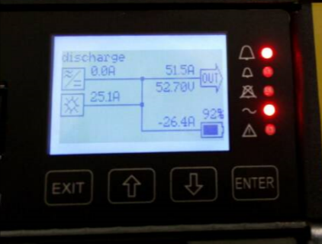
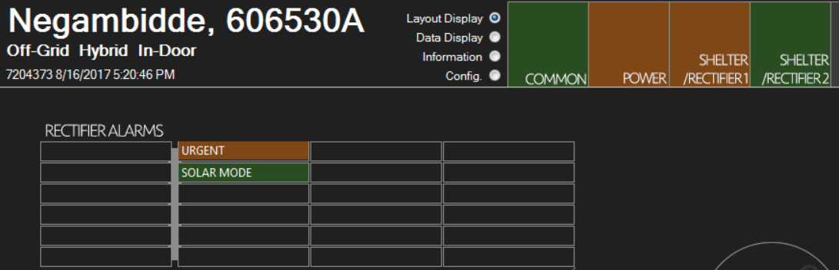
.
After all the configurations, you should have the orion display as below;
With the right galooli hardware and config at site this should be interpreted as solar mode.

Slide 13
Thank you

